Slide 1
Updating the Code for Phase-1 Implementation
Date- 08-Jan-2026

Slide 2
1. Model Architecture (Phase-1)
The model uses a shared backbone to extract features, but splits into two distinct "heads" for prediction:
Backbone: It utilizes EfficientNetB0, pre-trained on ImageNet, as the feature extractor for both modalities.
Dual Inputs: It accepts an X-ray input and a CT input simultaneously through a tf.data.Dataset.zip structure.
Specialized Outputs:
X-ray Head: Uses a Sigmoid activation for Multi-label classification (a patient can have multiple conditions like Edema and Lung Opacity at once).
CT Head: Uses a Softmax activation for Multi-class classification (predicting a single category: Benign, Malignant, or Normal).

Slide 3
2. Specialized Focal Losses
To handle potential class imbalances (where some diseases appear more often than others), the code implements custom Focal Loss functions:
Binary Focal Loss: Applied to the X-ray head to handle the multi-label nature of chest conditions.
Categorical Focal Loss: Applied to the CT head to handle the mutually exclusive cancer categories.
Mechanism: These losses down-weight "easy" examples and force the model to focus on "hard" examples during training by using a gamma factor.

Slide 4
3. Data Pipeline & Unpaired Strategy
Because the images are unpaired, the load_and_prepare_data function manages them as follows:
Loading: It loads up to 1000 X-rays and 700 CT images per class.
Zipping: It uses tf.data.Dataset.zip to create pairs of images for the model to process in each batch.
Training Signal: Even though the images in a batch pair aren't from the same patient, the model learns the correct features for X-rays from the X-ray loss and CT features from the CT loss independently.

Slide 5
4. Comprehensive Evaluation Utilities
The code includes extensive visualization tools to diagnose model performance:
Confusion Matrices: Separated for X-ray (multi-label heatmap) and CT (multi-class heatmap).
Precision-Recall Curves: Crucial for medical data to show the trade-off between identifying all cases (recall) and ensuring accuracy in those identifications (precision).
Augmented Reports: Generates standard metrics (Precision, Recall, F1-score) and adds a specific "Accuracy" row to provide a holistic view of diagnostic performance.

Slide 6
5. Execution Flow
Prepare Data: Loads images from Google Drive, splits them into training and validation sets, and zips them into the dual-input format.
Compile: Sets up the Adam optimizer and assigns the specific Focal Losses to each output head.
Train: Runs for 20 epochs with Early Stopping (to prevent overfitting) and Learning Rate Reduction (to fine-tune as training progresses).
Validate: Generates the final diagnostic reports and training curves to evaluate how well Phase 1 has established a baseline.

Slide 7
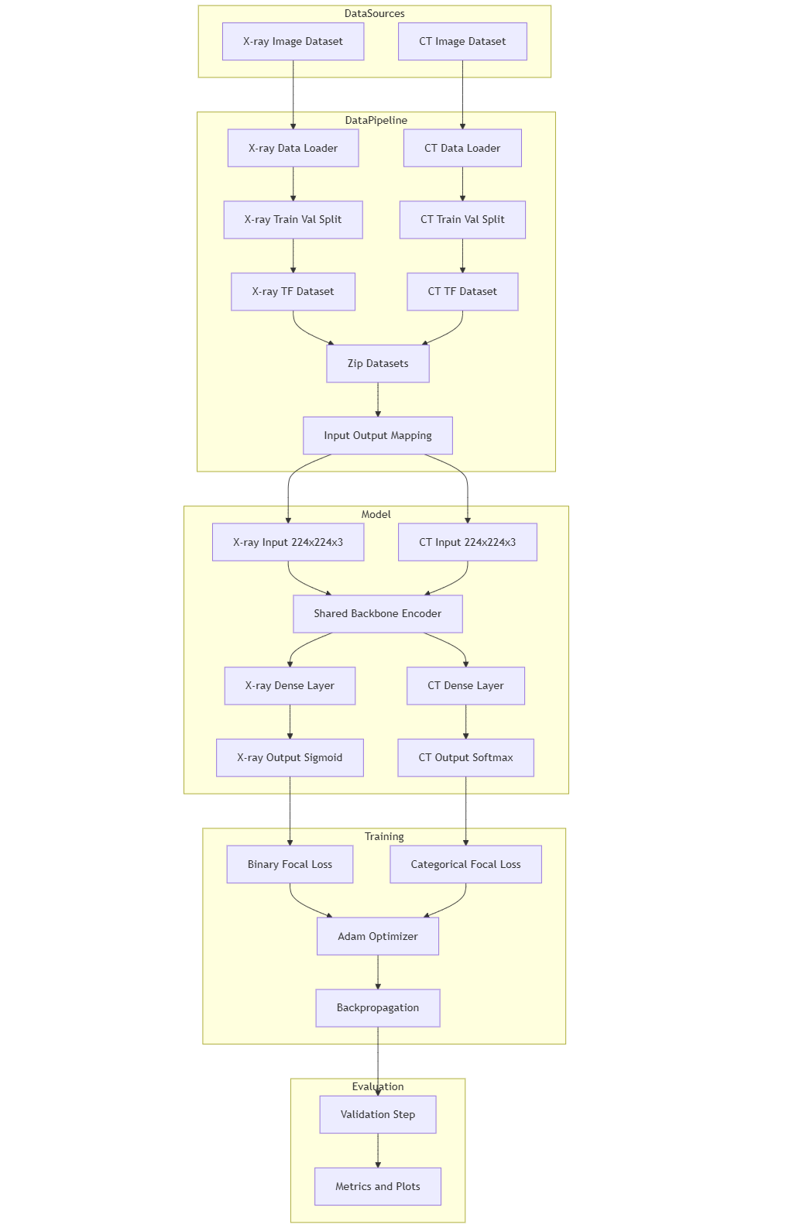
High-Level Architecture Diagram

Slide 8
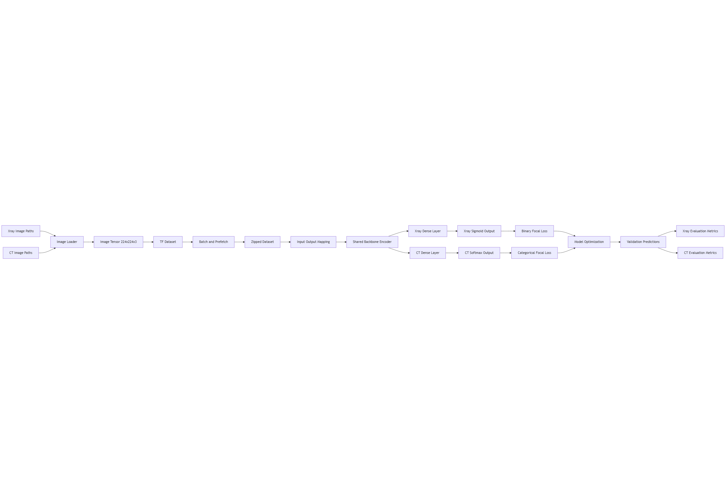
Data Flow Diagram

Slide 9
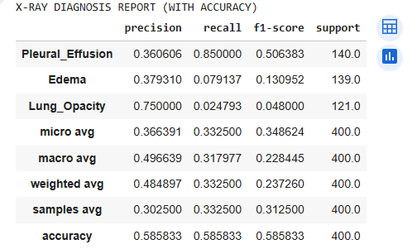
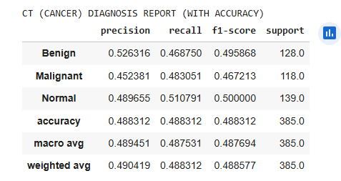
Results- EfficientNetB0

Slide 10
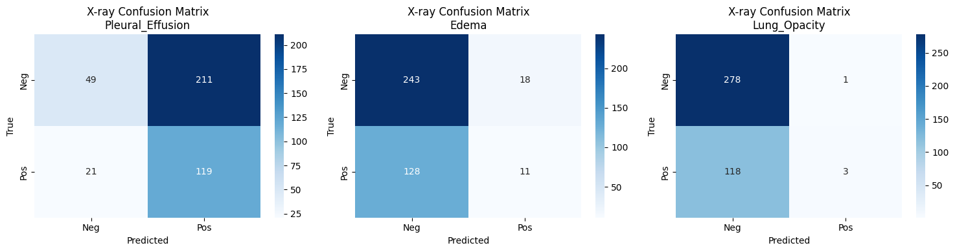
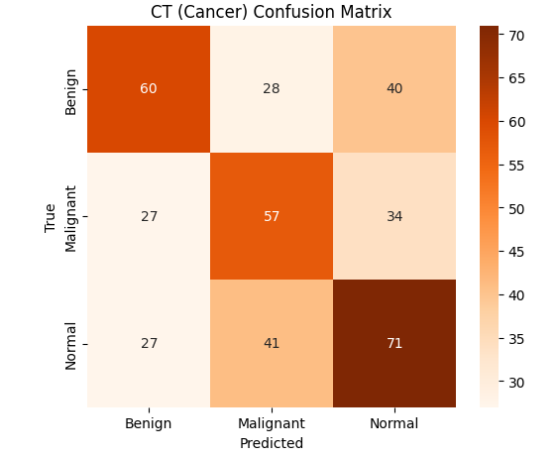
Results- EfficientNetB0

Slide 11
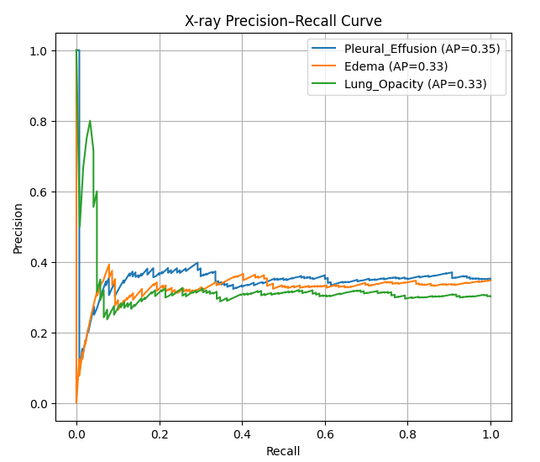
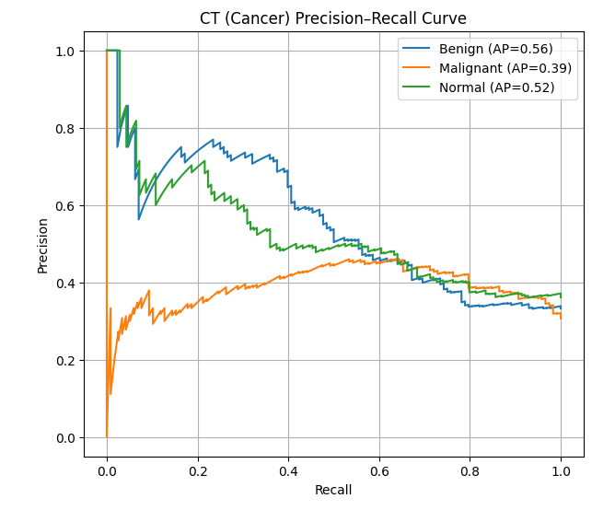
Results- EfficientNetB0

Slide 12
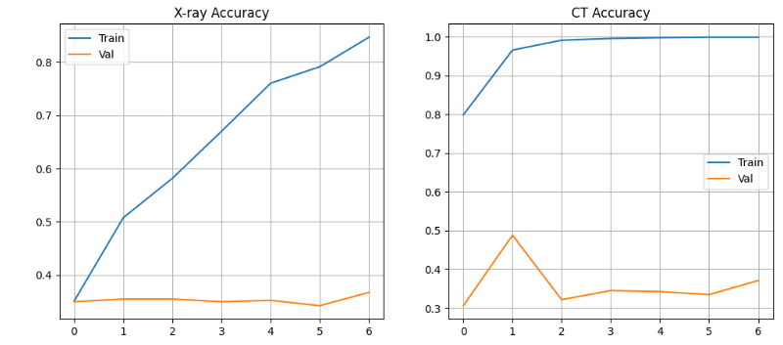
Results- EfficientNetB0

Slide 13
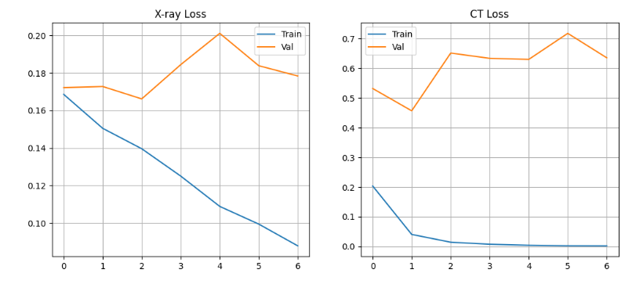
Results- EfficientNetB0

Slide 14
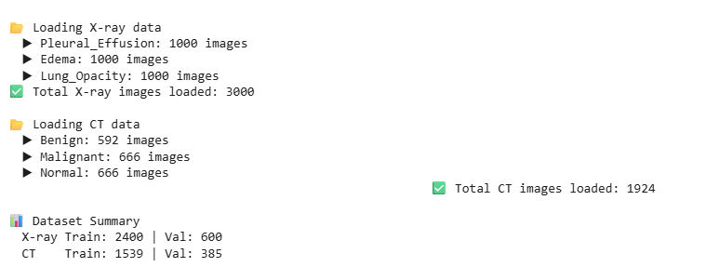
Results- MobileNet

Slide 15
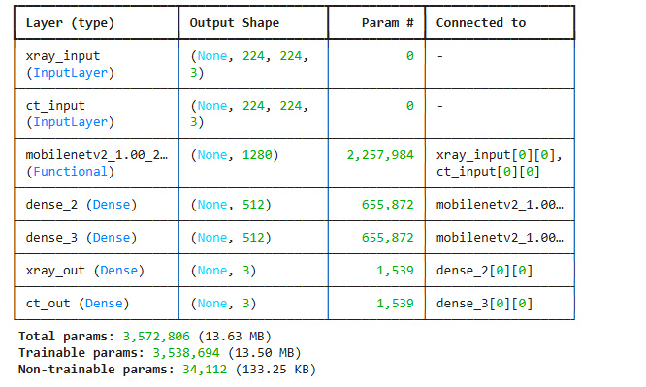
Results- MobileNet

Slide 16
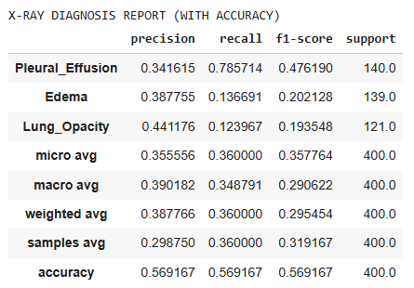
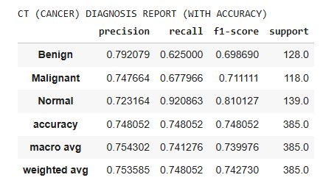
Results- MobileNet

Slide 17
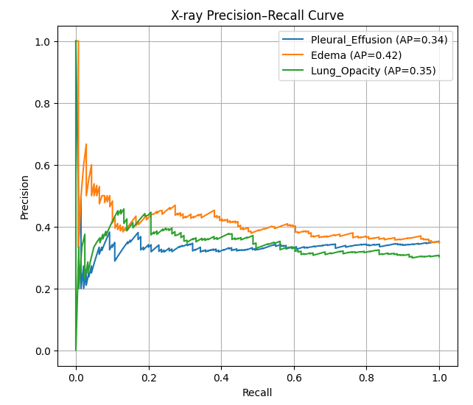
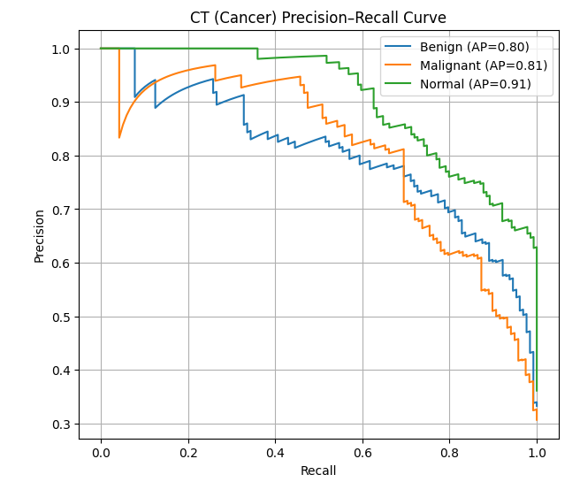
Results- MobileNet

Slide 18
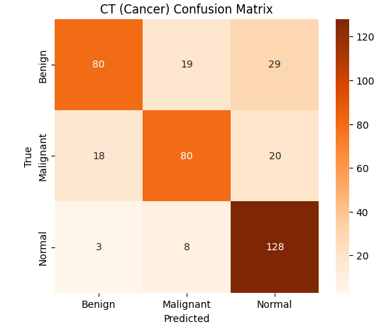
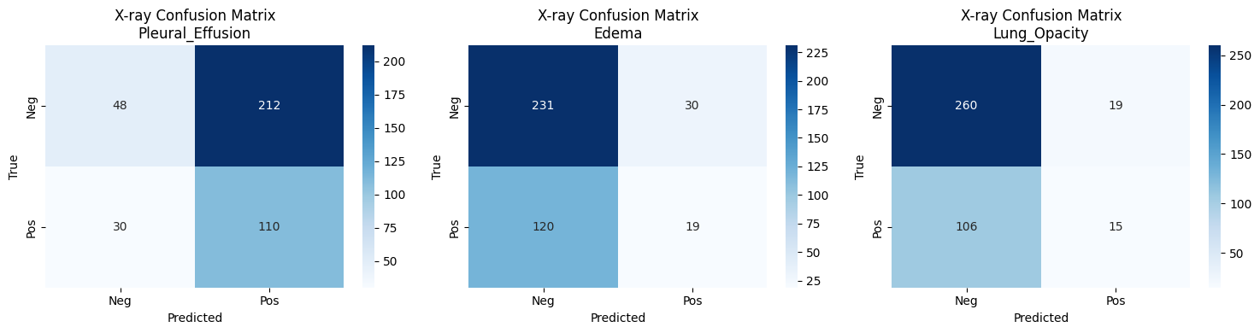
Results- MobileNet

Slide 19
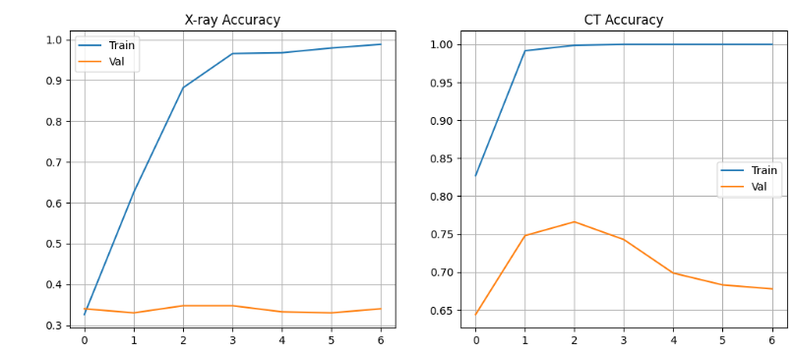
Results- MobileNet

Slide 20
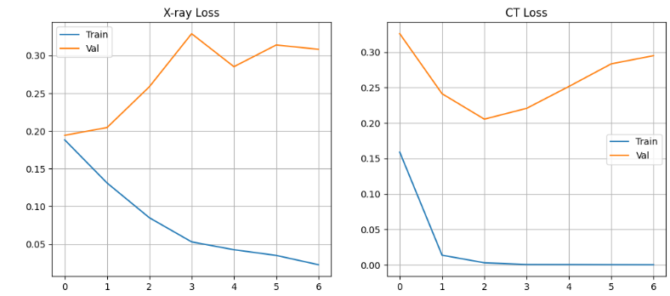
Results- MobileNet

Slide 21
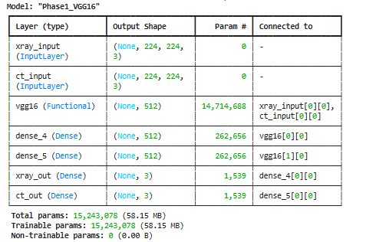
Results- VGG16

Slide 22
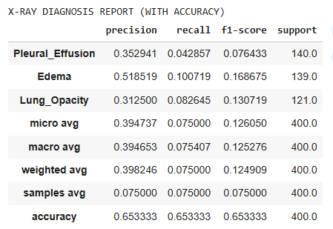
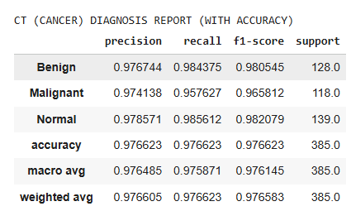
Results- VGG16

Slide 23
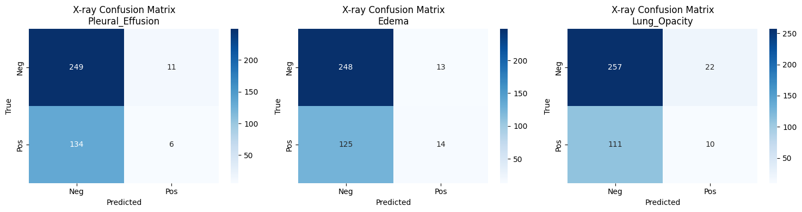
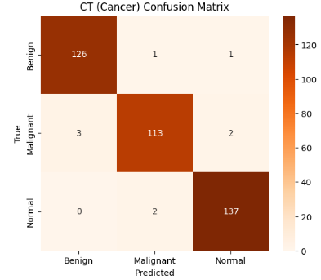
Results- VGG16

Slide 24
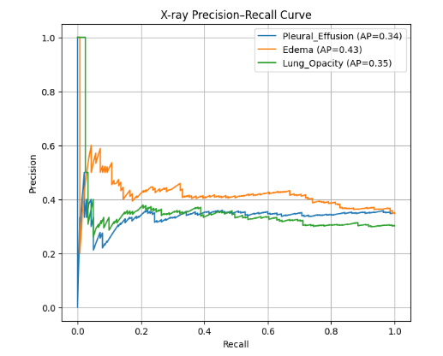
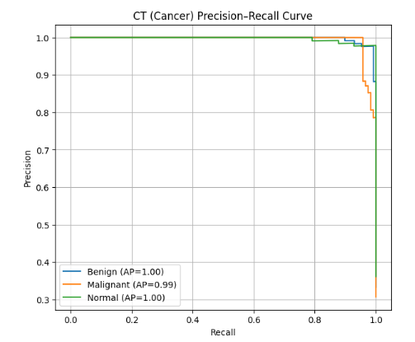
Results- VGG16

Slide 25
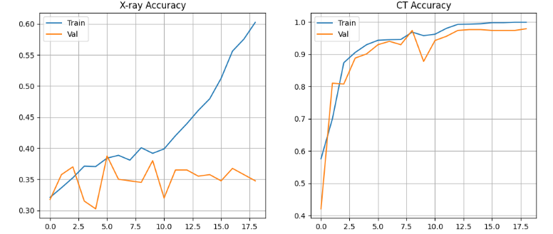
Results- VGG16

Slide 26
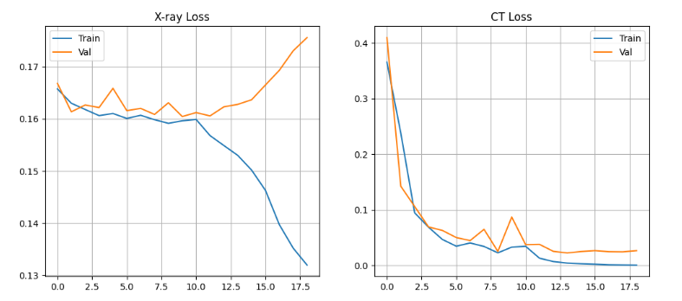
Results- VGG16

Slide 27
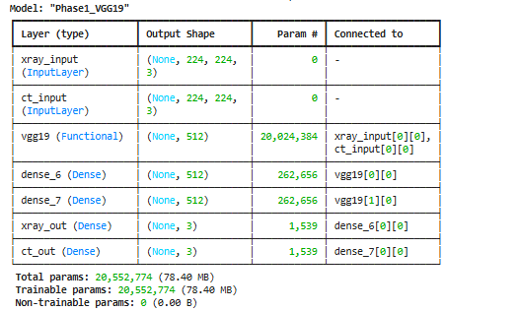
Results- VGG19

Slide 28
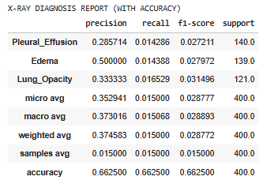
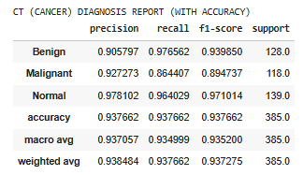
Results- VGG19

Slide 29
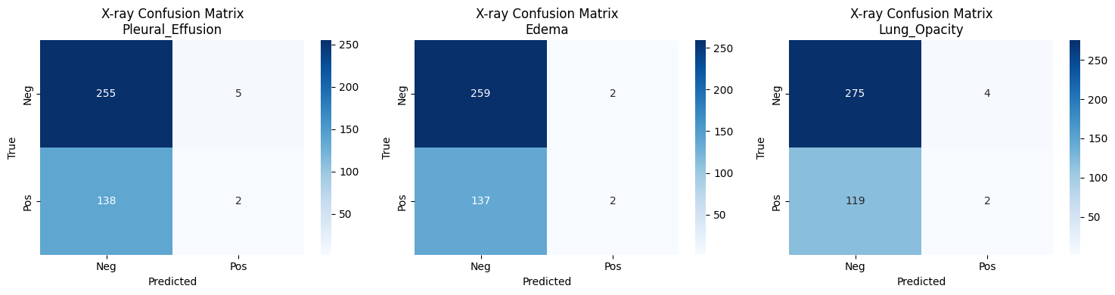
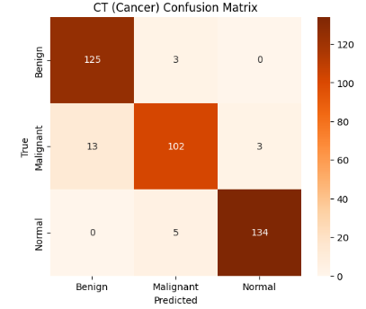
Results- VGG19

Slide 30
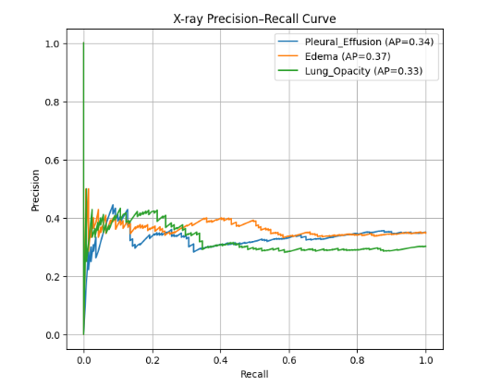
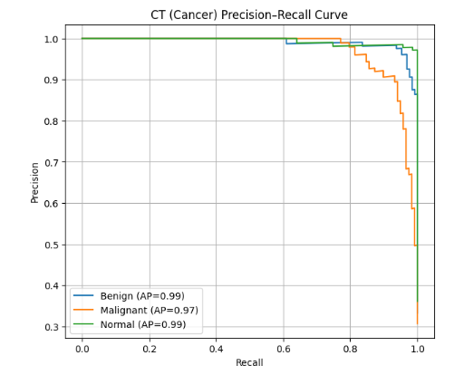
Results- VGG19

Slide 31
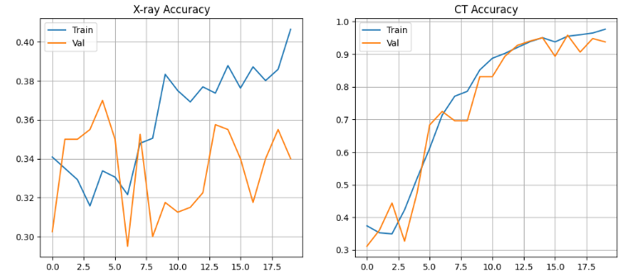
Results- VGG19

Slide 32
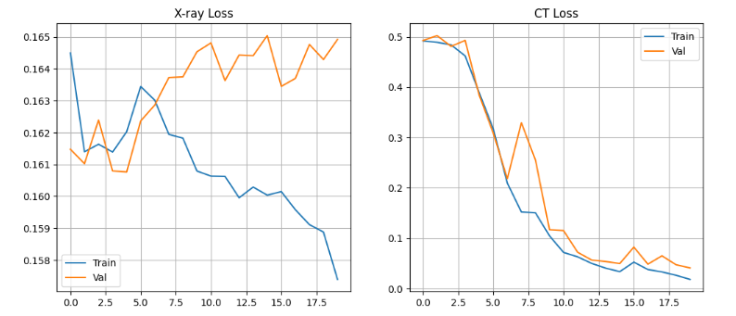
Results- VGG19

Slide 33
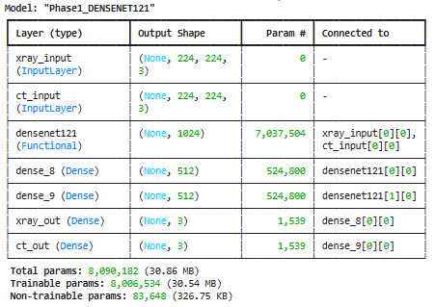
Results- DenseNet121

Slide 34
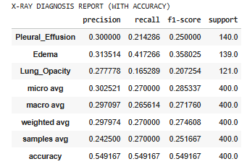
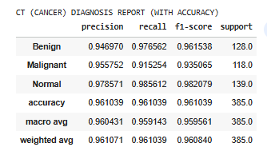
Results- DenseNet121

Slide 35
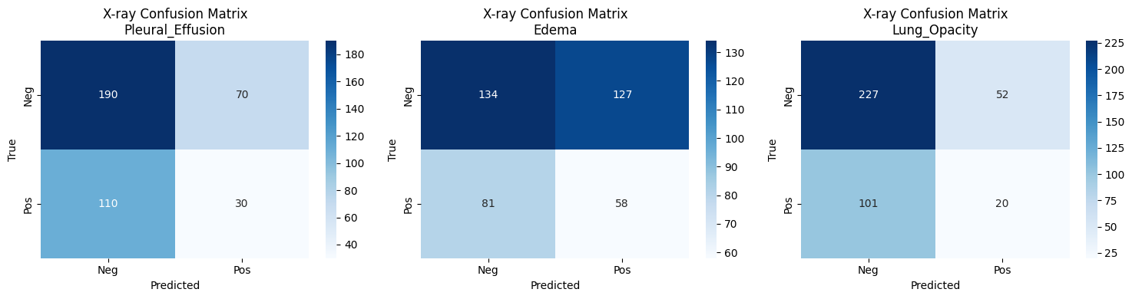
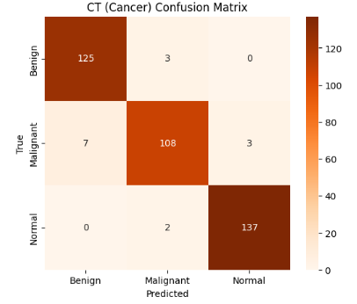
Results- DenseNet121

Slide 36
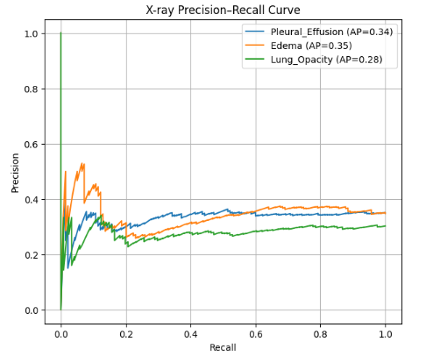
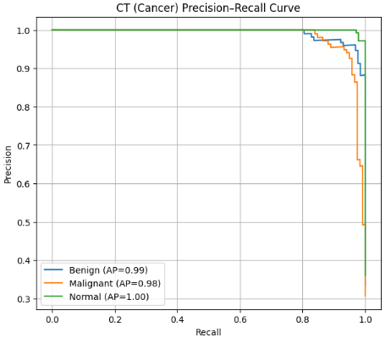
Results- DenseNet121

Slide 37
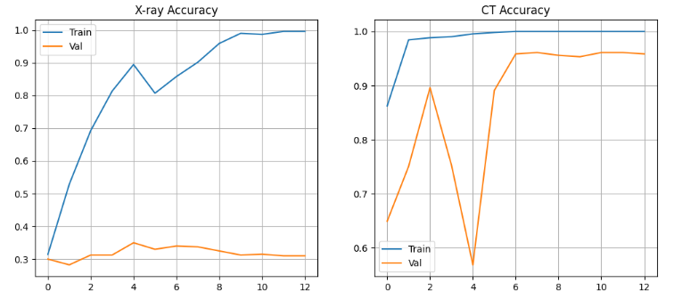
Results- DenseNet121

Slide 38
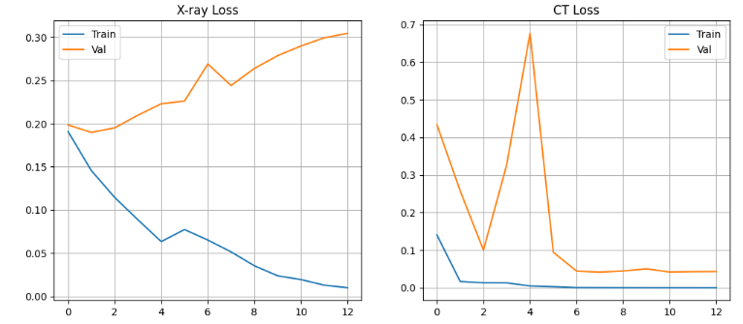
Results- DenseNet121

Slide 39
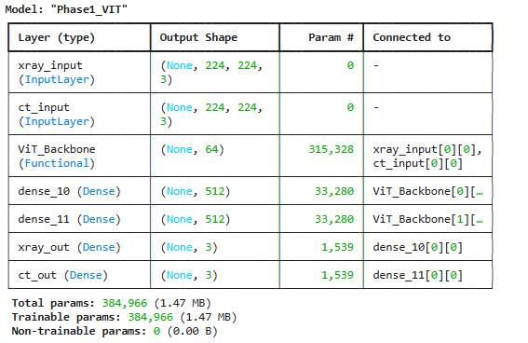
Results- vit

Slide 40
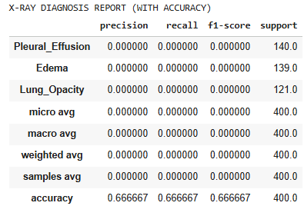
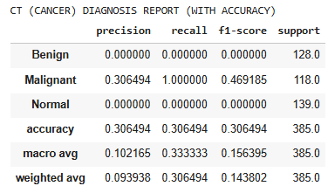
Results- vit

Slide 41


Results- vit

Slide 42


Results- vit

Slide 43

Results- vit

Slide 44

Results- vit

Slide 45

Results- xception

Slide 46


Results- xception

Slide 47


Results- xception

Slide 48


Results- xception

Slide 49

Results- xception

Slide 50

Results- xception

Slide 51

Results- VGG16

Slide 52


Results- VGG16

Slide 53


Results- VGG16

Slide 54


Results- VGG16

Slide 55

Results- VGG16

Slide 56

Results- VGG16

Slide 57

Results- ResNet50

Slide 58


Results- ResNet50

Slide 59


Results- ResNet50

Slide 60


Results- ResNet50

Slide 61

Results- ResNet50

Slide 62

Results- ResNet50

Slide 63

Results- ResNet50v2

Slide 64


Results- ResNet50v2

Slide 65


Results- ResNet50v2

Slide 66


Results- ResNet50v2

Slide 67

Results- ResNet50v2

Slide 68

Results- ResNet50v2

Slide 69

Results- ResNet101

Slide 70


Results- ResNet101

Slide 71


Results- ResNet101

Slide 72


Results- ResNet101

Slide 73

Results- ResNet101

Slide 74

Results- ResNet101

Slide 75

Results- ResNet101v2

Slide 76


Results- ResNet101v2

Slide 77


Results- ResNet101v2

Slide 78


Results- ResNet101v2

Slide 79

Results- ResNet101v2

Slide 80

Results- ResNet101v2

Slide 81

Results- ResNet152

Slide 82


Results- ResNet152

Slide 83


Results- ResNet152

Slide 84


Results- ResNet152

Slide 85

Results- ResNet152

Slide 86

Results- ResNet152

Slide 87

Results- ResNet152 v2

Slide 88


Results- ResNet152 v2

Slide 89


Results- ResNet152 v2

Slide 90


Results- ResNet152 v2

Slide 91

Results- ResNet152 v2

Slide 92

Results- Inceptionv3

Slide 93


Results- Inceptionv3

Slide 94


Results- Inceptionv3

Slide 95


Results- Inceptionv3

Slide 96

Results- Inceptionv3

Slide 97

Results- Inceptionv3

Slide 98

Results- InceptionResnetV2

Slide 99


Results- InceptionResnetV2

Slide 100


Results- InceptionResnetV2

Slide 101


Results- InceptionResnetV2

Slide 102

Results- InceptionResnetV2

Slide 103

Results- InceptionResnetV2

Slide 104

Results- MobilenetV2

Slide 105


Results- MobilenetV2

Slide 106


Results- MobilenetV2

Slide 107


Results- MobilenetV2

Slide 108

Results- MobilenetV2

Slide 109

Results- MobilenetV2

Slide 110

Results- DesneNet169

Slide 111


Results- DesneNet169

Slide 112


Results- DesneNet169

Slide 113


Results- DesneNet169

Slide 114

Results- DesneNet169

Slide 115

Results- DesneNet169

Slide 116

Results- DesneNet201

Slide 117


Results- DesneNet201

Slide 118


Results- DesneNet201

Slide 119


Results- DesneNet201

Slide 120

Results- DesneNet201

Slide 121

Results- DesneNet201

Slide 122

Results- NasNetmobile

Slide 123


Results- NasNetmobile

Slide 124


Results- NasNetmobile

Slide 125


Results- NasNetmobile

Slide 126

Results- NasNetmobile

Slide 127

Results- NasNetmobile

Slide 128

Results- NasNetLarge

Slide 129


Results- NasNetLarge

Slide 130


Results- NasNetLarge

Slide 131


Results- NasNetLarge

Slide 132

Results- NasNetLarge

Slide 133

Results- NasNetLarge

Slide 134

Results- Efficientnetv2s

Slide 135


Results- Efficientnetv2s

Slide 136


Results- Efficientnetv2s

Slide 137


Results- Efficientnetv2s

Slide 138

Results- Efficientnetv2s

Slide 139

Results- Efficientnetv2s

Slide 140

Results- ConvNextBase

Slide 141


Results- ConvNextBase

Slide 142
Results- ConvNextBase

Slide 143


Results- ConvNextBase

Slide 144

Results- ConvNextBase

Slide 145

Results- ConvNextBase

